Slide 1
USED TO
Sila Inglés

Slide 2
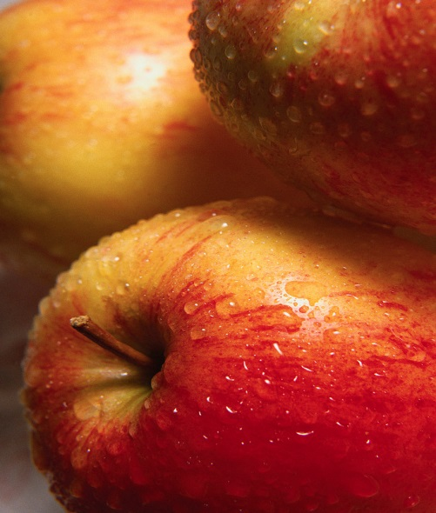
Used to= solía
USED TO: HÁBITOS PASADOS
En presente:
He eats apples
He usually eats apples
Vs.
He used to eat apples

Slide 3
USED TO + Infinitivo
Presente afirmativo
I used to dance all night long

Slide 4
Forma Negativa: negación
I didn’t use to dance all night long

Slide 5
Forma interrogativa: Pregunta
Did I he use to dance all night long?

Slide 6
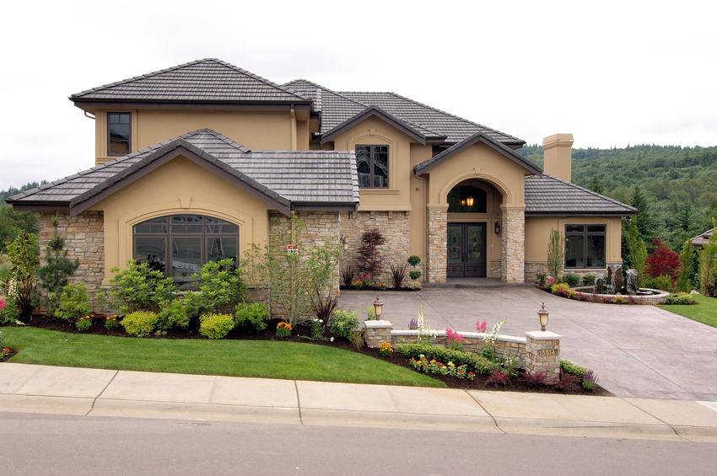
BE USED TO: acostumbrado
ACOMPAÑADO DE
Gerundio
Nombre
Pronombre
I am used to living in this house
I am used to this house
I am used to it

Slide 7
GET USED TO: acostumbrarse
ACOMPAÑADO DE
Gerundio
Nombre
Pronombre
I am getting used to the rain
I got used to living abroad
I’m getting used to you

Slide 8
BECOME USED TO
También significa acostumbrarse
Más formal
He is becoming used to the bad weather

Slide 9
Ejemplos
Afirmativo:
She used to spend her free time reading comics
Negativo
He didn’t use to spend her free time reading comics
Pregunta
Did she use to spend her free time reading comics?

Slide 10
Afirmativo:
They used to attend all the meetings
Negativo
They didn’t use to attend all the meetings
Pregunta
Did they use to attend all the meetings?

Slide 11

Be used to-acostumbrad@
Get used to-Acostumbrarse
He is used to the heat. He lives in a very hot country.
When he arrived in Egypt, he found it very difficult to get used to the heat, as he is not used to it.

Slide 12
BE USED TO
GET USED TO
I __________ the cold. I come from Alaska.
We __________ eating food without salt.
They __________ (not) working overtime
Richard finds it very difficult to __________ driving on the left.
I will never __________ competing against my brother.
She will never __________ rude men.

Slide 13
Ven a visitarme
Blog: http://aprendeinglessila.com/
Facebook: https://www.facebook.com/AprendeInglesSila
Twitter: @InglesSila

